Slide 1

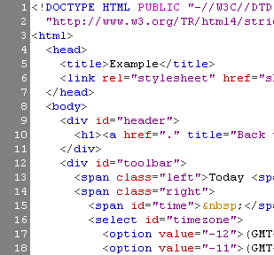


HTML Basics
HTML, Text, Images, Tables, Forms
Svetlin Nakov
Telerik Corporation
www.telerik.com

Slide 2
Table of Contents
Introduction to HTML
How the Web Works?
What is a Web Page?
My First HTML Page
Basic Tags: Hyperlinks, Images, Formatting
Headings and Paragraphs
HTML in Details
The <!DOCTYPE> Declaration
The <head> Section: Title, Meta, Script, Style

Slide 3
Table of Contents (2)
HTML in Details
The <body> Section
Text Styling and Formatting Tags
Hyperlinks: <a>
Hyperlinks and Sections
Images: <img>
Lists: <ol>, <ul> and <dl>
HTML Special Characters
The <div> and <span> elements

Slide 4



How the Web Works?
WWW use classical client / server architecture
HTTP is text-based request-response protocol
HTTP
Page request
HTTP
Server response
Server running Web Server Software (IIS, Apache, etc.)
Client running a Web Browser

Slide 5
What is a Web Page?
Web pages are text files containing HTML
HTML – Hyper Text Markup Language
A notation for describing
document structure (semantic markup)
formatting (presentation markup)
Looks (looked?) like:
A Microsoft Word document
The markup tags provide information about the page content structure

Slide 6
Creating HTML Pages
An HTML file must have an .htm or .html file extension
HTML files can be created with text editors:
NotePad, NotePad ++, PSPad
Or HTML editors (WYSIWYG Editors):
Microsoft FrontPage
Macromedia Dreamweaver
Netscape Composer
Microsoft Word

Slide 7



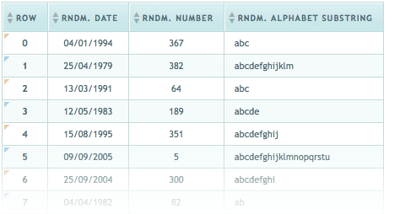

HTML Basics
Text, Images, Tables, Forms

Slide 8
HTML Structure
HTML is comprised of “elements” and “tags”
Begins with <html> and ends with </html>
When writing XHTML, must define a namespace
Elements (tags) are nested one inside another:
Tags have attributes:
HTML describes structure using two main sections: <head> and <body>
<html xmlns="http://www.w3.org/1999/xhtml">
<html> <head></head> <body></body> </html>
<img src="logo.jpg" alt="logo" />

Slide 9
HTML Code Formatting
The HTML source code should be formatted to increase readability and facilitate debugging.
Every block element should start on a new line.
Every nested (block) element should be indented.
Browsers ignore multiple whitespaces in the page source, so formatting is harmless.
For performance reasons, formatting can be sacrificed.

Slide 10
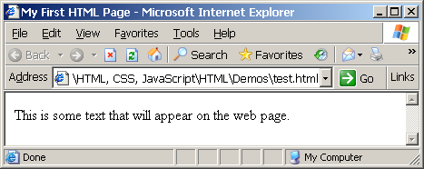
First HTML Page
test.html
<!DOCTYPE HTML>
<html>
<head>
<title>My First HTML Page</title>
</head>
<body>
<p>This is some text...</p>
</body>
</html>

Slide 11
First HTML Page: Tags
<!DOCTYPE HTML>
<html>
<head>
<title>My First HTML Page</title>
</head>
<body>
<p>This is some text...</p>
</body>
</html>
Opening tag
Closing tag
An HTML element consists of an opening tag, a closing tag and the content inside.

Slide 12
First HTML Page: Header
HTML header
<!DOCTYPE HTML>
<html>
<head>
<title>My First HTML Page</title>
</head>
<body>
<p>This is some text...</p>
</body>
</html>

Slide 13
First HTML Page: Body
<!DOCTYPE HTML>
<html>
<head>
<title>My First HTML Page</title>
</head>
<body>
<p>This is some text...</p>
</body>
</html>
HTML body

Slide 14
Some Simple Tags
Hyperlink Tags
Image Tags
Text formatting tags
<a href="http://www.telerik.com/"
title="Telerik">Link to Telerik Web site</a>
<img src="logo.gif" alt="logo" />
This text is <em>emphasized.</em>
<br />new line<br />
This one is <strong>more emphasized.</strong>

Slide 15
Some Simple Tags – Example
some-tags.html
<!DOCTYPE HTML>
<html>
<head>
<title>Simple Tags Demo</title>
</head>
<body>
<a href="http://www.telerik.com/" title=
"Telerik site">This is a link.</a>
<br />
<img src="logo.gif" alt="logo" />
<br />
<strong>Bold</strong> and <em>italic</em> text.
</body>
</html>

Slide 16
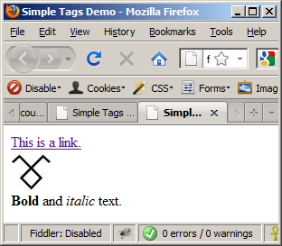
Some Simple Tags – Example (2)
some-tags.html
<!DOCTYPE HTML>
<html>
<head>
<title>Simple Tags Demo</title>
</head>
<body>
<a href="http://www.telerik.com/" title=
"Telerik site">This is a link.</a>
<br />
<img src="logo.gif" alt="logo" />
<br />
<strong>Bold</strong> and <em>italic</em> text.
</body>
</html>

Slide 17


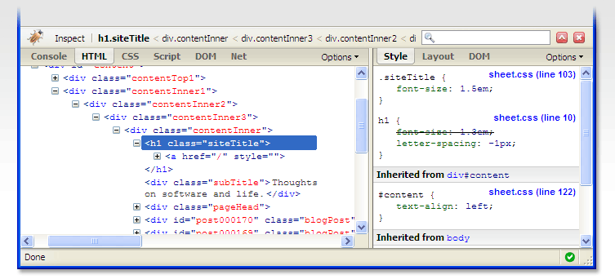

Some HTML Tags
Live Demo

Slide 18
Tags Attributes
Tags can have attributes
Attributes specify properties and behavior
Example:
Few attributes can apply to every element:
id, style, class, title
The id is unique in the document
Content of title attribute is displayed as hint when the element is hovered with the mouse
Some elements have obligatory attributes
Attribute alt with value "logo"
<img src="logo.gif" alt="logo" />

Slide 19
Headings and Paragraphs
Heading Tags (h1 – h6)
Paragraph Tags
Sections: div and span
<h1>Heading 1</h1>
<h2>Sub heading 2</h2>
<h3>Sub heading 3</h3>
<p>This is my first paragraph</p>
<p>This is my second paragraph</p>
<div style="background: skyblue;">
This is a div</div>

Slide 20
Headings and Paragraphs – Example
headings.html
<!DOCTYPE HTML>
<html>
<head><title>Headings and paragraphs</title></head>
<body>
<h1>Heading 1</h1>
<h2>Sub heading 2</h2>
<h3>Sub heading 3</h3>
<p>This is my first paragraph</p>
<p>This is my second paragraph</p>
<div style="background:skyblue">
This is a div</div>
</body>
</html>

Slide 21
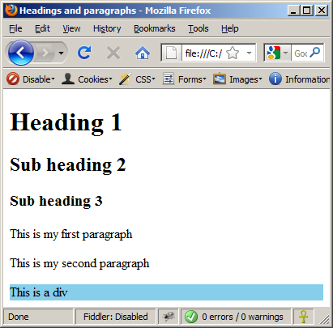
Headings and Paragraphs – Example (2)
headings.html
<!DOCTYPE HTML>
<html>
<head><title>Headings and paragraphs</title></head>
<body>
<h1>Heading 1</h1>
<h2>Sub heading 2</h2>
<h3>Sub heading 3</h3>
<p>This is my first paragraph</p>
<p>This is my second paragraph</p>
<div style="background:skyblue">
This is a div</div>
</body>
</html>

Slide 22

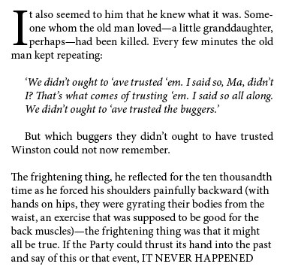
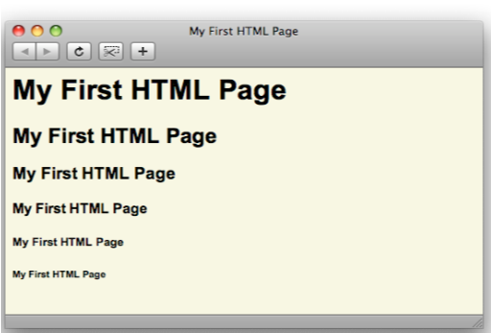
Headings and Paragraphs
Live Demo

Slide 23
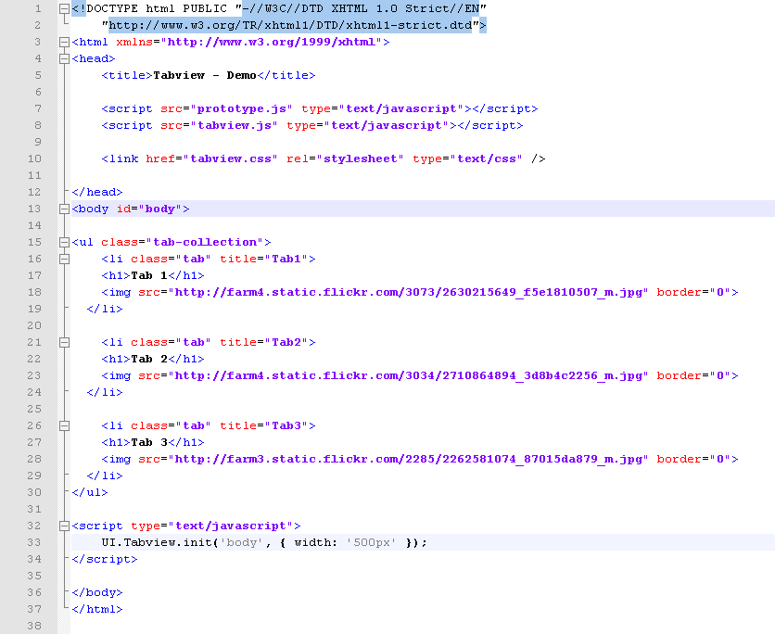
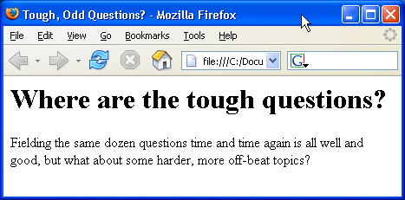
Introduction to HTML
HTML Document Structure in Depth

Slide 24
Preface
It is important to have the correct vision and attitude towards HTML
HTML is only about structure, not appearance
Browsers tolerate invalid HTML code and parse errors – you should not.

Slide 25
The <!DOCTYPE> Declaration
HTML documents must start with a document type definition (DTD)
It tells web browsers what type is the served code
Possible versions: HTML 4.01, XHTML 1.0 (Transitional or Strict), XHTML 1.1, HTML 5
Example:
See http://w3.org/QA/2002/04/valid-dtd-list.html for a list of possible doctypes
<!DOCTYPE html PUBLIC "-//W3C//DTD XHTML 1.0 Transitional//EN" "http://www.w3.org/TR/xhtml1/DTD/xhtml1-transitional.dtd">

Slide 26

HTML vs. XHTML
XHTML is more strict than HTML
Tags and attribute names must be in lowercase
All tags must be closed (<br/>, <img/>) while HTML allows <br> and <img> and implies missing closing tags (<p>par1 <p>par2)
XHTML allows only one root <html> element (HTML allows more than one)

Slide 27
XHTML vs. HTML (2)
Many element attributes are deprecated in XHTML, most are moved to CSS
Attribute minimization is forbidden, e.g.
Note: Web browsers load XHTML faster than HTML and valid code faster than invalid!
<input type="checkbox" checked>
<input type="checkbox" checked="checked" />

Slide 28
The <head> Section
Contains information that doesn’t show directly on the viewable page
Starts after the <!doctype> declaration
Begins with <head> and ends with </head>
Contains mandatory single <title> tag
Can contain some other tags, e.g.
<meta>
<script>
<style>
<!–- comments -->

Slide 29

<head> Section: <title> tag
Title should be placed between <head> and </head> tags
Used to specify a title in the window titlebar
Search engines and people rely on titles
<title>Telerik Academy – Winter Season 2009/2010 </title>

Slide 30
<head> Section: <meta>
Meta tags additionally describe the content contained within the page
<meta name="description" content="HTML tutorial" />
<meta name="keywords" content="html, web design, styles" />
<meta name="author" content="Chris Brewer" />
<meta http-equiv="refresh" content="5; url=http://www.telerik.com" />

Slide 31
<head> Section: <script>
The <script> element is used to embed scripts into an HTML document
Script are executed in the client's Web browser
Scripts can live in the <head> and in the <body> sections
Supported client-side scripting languages:
JavaScript (it is not Java!)
VBScript
JScript

Slide 32
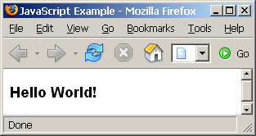
The <script> Tag – Example
scripts-example.html
<!DOCTYPE HTML>
<html>
<head>
<title>JavaScript Example</title>
<script type="text/javascript">
function sayHello() {
document.write("<p>Hello World!<\/p>");
}
</script>
</head>
<body>
<script type=
"text/javascript">
sayHello();
</script>
</body>
</html>

Slide 33
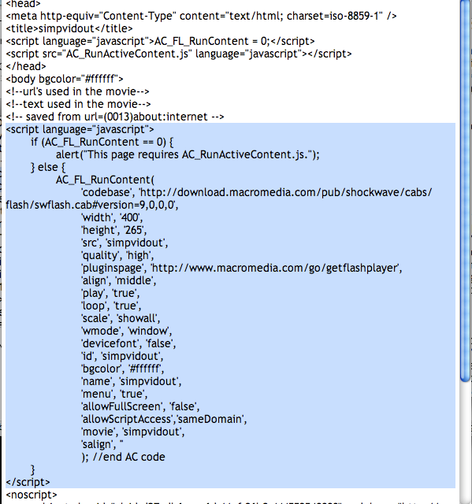




Using Scripts
Live Demo

Slide 34
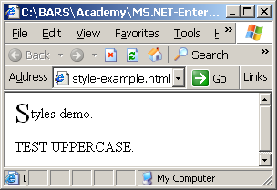
<head> Section: <style>
The <style> element embeds formatting information (CSS styles) into an HTML page
style-example.html
<html>
<head>
<style type="text/css">
p { font-size: 12pt; line-height: 12pt; }
p:first-letter { font-size: 200%; }
span { text-transform: uppercase; }
</style>
</head>
<body>
<p>Styles demo.<br />
<span>Test uppercase</span>.
</p>
</body>
</html>

Slide 35

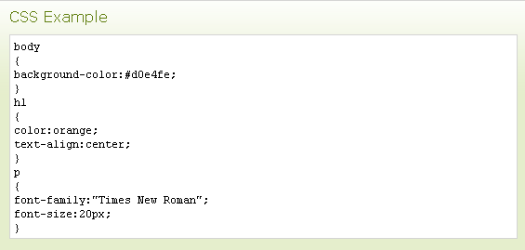


Embedding CSS Styles
Live Demo

Slide 36
Comments: <!-- --> Tag
Comments can exist anywhere between the <html></html> tags
Comments start with <!-- and end with -->
<!–- Telerik Logo (a JPG file) -->
<img src="logo.jpg" alt=“Telerik Logo">
<!–- Hyperlink to the web site -->
<a href="http://telerik.com/">Telerik</a>
<!–- Show the news table -->
<table class="newstable">
...

Slide 37
<body> Section: Introduction
The <body> section describes the viewable portion of the page
Starts after the <head> </head> section
Begins with <body> and ends with </body>
<html>
<head><title>Test page</title></head>
<body>
<!-- This is the Web page body -->
</body>
</html>

Slide 38
Text Formatting
Text formatting tags modify the text between the opening tag and the closing tag
Ex. <b>Hello</b> makes “Hello” bold
<b></b> | bold
<i></i> | italicized
<u></u> | underlined
<sup></sup> | Sample^{superscript}
<sub></sub> | Sample_{subscript}
<strong></strong> | strong
<em></em> | emphasized
<pre></pre> | Preformatted text
<blockquote></blockquote> | Quoted text block
<del></del> | Deleted text – strike through
38

Slide 39
Text Formatting – Example
text-formatting.html
<!DOCTYPE html PUBLIC "-//W3C//DTD XHTML 1.0 Transitional//EN"
"http://www.w3.org/TR/xhtml1/DTD/xhtml1-transitional.dtd">
<html>
<head>
<title>Page Title</title>
</head>
<body>
<h1>Notice</h1>
<p>This is a <em>sample</em> Web page.</p>
<p><pre>Next paragraph:
preformatted.</pre></p>
<h2>More Info</h2>
<p>Specifically, we’re using XHMTL 1.0 transitional.<br />
Next line.</p>
</body>
</html>

Slide 40
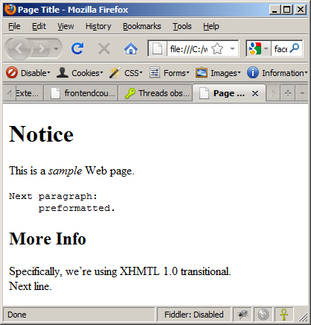
Text Formatting – Example (2)
text-formatting.html
<!DOCTYPE html PUBLIC "-//W3C//DTD XHTML 1.0 Transitional//EN"
"http://www.w3.org/TR/xhtml1/DTD/xhtml1-transitional.dtd">
<html>
<head>
<title>Page Title</title>
</head>
<body>
<h1>Notice</h1>
<p>This is a <em>sample</em> Web page.</p>
<p><pre>Next paragraph:
preformatted.</pre></p>
<h2>More Info</h2>
<p>Specifically, we’re using XHMTL 1.0 transitional.<br />
Next line.</p>
</body>
</html>

Slide 41
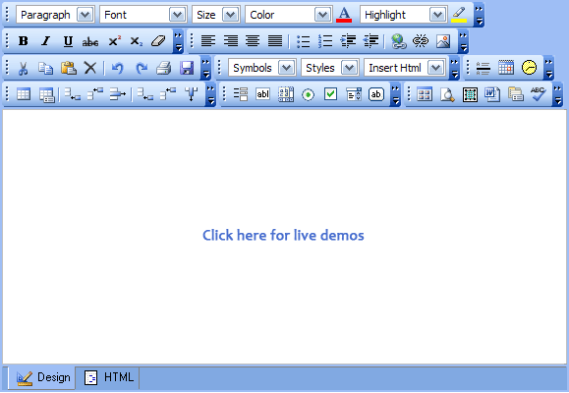




Text Formatting
Live Demo

Slide 42
Hyperlinks: <a> Tag
Link to a document called form.html on the same server in the same directory:
Link to a document called parent.html on the same server in the parent directory:
Link to a document called cat.html on the same server in the subdirectory stuff:
<a href="form.html">Fill Our Form</a>
<a href="../parent.html">Parent</a>
<a href="stuff/cat.html">Catalog</a>

Slide 43
Hyperlinks: <a> Tag (2)
Link to an external Web site:
Always use a full URL, including "http://", not just "www.somesite.com"
Using the target="_blank" attribute opens the link in a new window
Link to an e-mail address:
<a href="http://www.devbg.org" target="_blank">BASD</a>
<a href="mailto:bugs@example.com?subject=Bug+Report">
Please report bugs here (by e-mail only)</a>

Slide 44
Hyperlinks: <a> Tag (3)
Link to a document called apply-now.html
On the same server, in same directory
Using an image as a link button:
Link to a document called index.html
On the same server, in the subdirectory english of the parent directory:
<a href="apply-now.html"><img
src="apply-now-button.jpg" /></a>
<a href="../english/index.html">Switch to English version</a>

Slide 45
Hyperlinks and Sections
Link to another location in the same document:
Link to a specific location in another document:
<a href="#section1">Go to Introduction</a>
...
<h2 id="section1">Introduction</h2>
<a href="chapter3.html#section3.1.1">Go to Section 3.1.1</a>
<!–- In chapter3.html -->
...
<div id="section3.1.1">
<h3>3.1.1. Technical Background</h3>
</div>

Slide 46
Hyperlinks – Example
hyperlinks.html
<a href="form.html">Fill Our Form</a> <br />
<a href="../parent.html">Parent</a> <br />
<a href="stuff/cat.html">Catalog</a> <br />
<a href="http://www.devbg.org" target="_blank">BASD</a> <br />
<a href="mailto:bugs@example.com?subject=Bug Report">Please report bugs here (by e-mail only)</a>
<br />
<a href="apply-now.html"><img src="apply-now-button.jpg” /></a> <br />
<a href="../english/index.html">Switch to English version</a> <br />

Slide 47
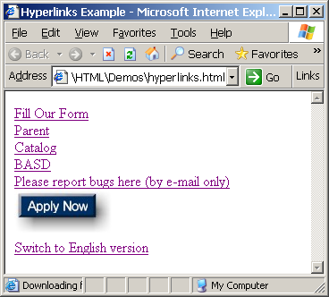
Hyperlinks – Example (2)
hyperlinks.html
<a href="form.html">Fill Our Form</a> <br />
<a href="../parent.html">Parent</a> <br />
<a href="stuff/cat.html">Catalog</a> <br />
<a href="http://www.devbg.org" target="_blank">BASD</a> <br />
<a href="mailto:bugs@example.com?subject=Bug Report">Please report bugs here (by e-mail only)</a>
<br />
<a href="apply-now.html"><img src="apply-now-button.jpg” /></a> <br />
<a href="../english/index.html">Switch to English version</a> <br />

Slide 48





Hyperlinks
Live Demo

Slide 49
Links to the Same Document – Example
links-to-same-document.html
<h1>Table of Contents</h1>
<p><a href="#section1">Introduction</a><br />
<a href="#section2">Some background</A><br />
<a href="#section2.1">Project History</a><br />
...the rest of the table of contents...
<!-- The document text follows here -->
<h2 id="section1">Introduction</h2>
... Section 1 follows here ...
<h2 id="section2">Some background</h2>
... Section 2 follows here ...
<h3 id="section2.1">Project History</h3>
... Section 2.1 follows here ...

Slide 50
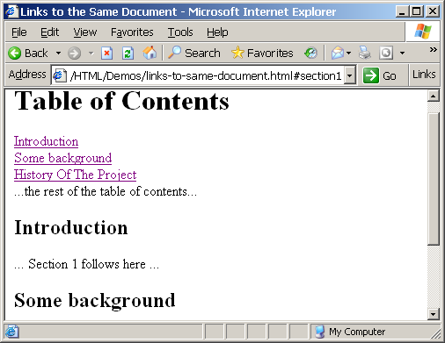
Links to the Same Document – Example (2)
links-to-same-document.html
<h1>Table of Contents</h1>
<p><a href="#section1">Introduction</a><br />
<a href="#section2">Some background</A><br />
<a href="#section2.1">Project History</a><br />
...the rest of the table of contents...
<!-- The document text follows here -->
<h2 id="section1">Introduction</h2>
... Section 1 follows here ...
<h2 id="section2">Some background</h2>
... Section 2 follows here ...
<h3 id="section2.1">Project History</h3>
... Section 2.1 follows here ...

Slide 51


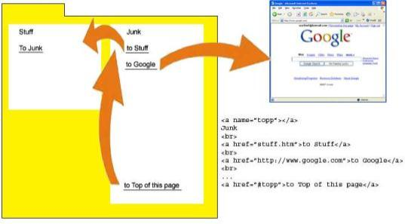
Links to the Same Document
Live Demo

Slide 52
Images: <img> tag
Inserting an image with <img> tag:
Image attributes:
Example:
<img src="/img/basd-logo.png">
src | Location of image file (relative or absolute)
alt | Substitute text for display (e.g. in text mode)
height | Number of pixels of the height
width | Number of pixels of the width
border | Size of border, 0 for no border
<img src="./php.png" alt="PHP Logo" />
52

Slide 53
Miscellaneous Tags
<hr />: Draws a horizontal rule (line):
<center></center>: Deprecated!
<font></font>: Deprecated!
<hr size="5" width="70%" />
<center>Hello World!</center>
<font size="3" color="blue">Font3</font>
<font size="+4" color="blue">Font+4</font>

Slide 54
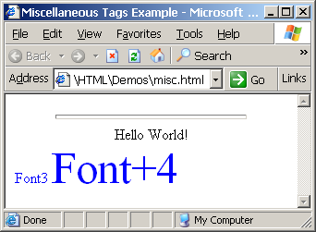
Miscellaneous Tags – Example
misc.html
<html>
<head>
<title>Miscellaneous Tags Example</title>
</head>
<body>
<hr size="5" width="70%" />
<center>Hello World!</center>
<font size="3" color="blue">Font3</font>
<font size="+4" color="blue">Font+4</font>
</body>
</html>

Slide 55


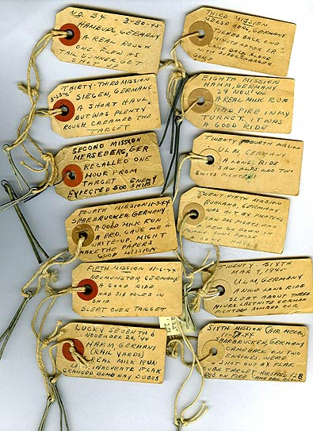

Miscellaneous Tags
Live Demo

Slide 56
Ordered Lists: <ol> Tag
Create an Ordered List using <ol></ol>:
Attribute values for type are 1, A, a, I, or i
<ol type="1">
<li>Apple</li>
<li>Orange</li>
<li>Grapefruit</li>
</ol>
Apple
Orange
Grapefruit
Apple
Orange
Grapefruit
Apple
Orange
Grapefruit
Apple
Orange
Grapefruit
Apple
Orange
Grapefruit

Slide 57
Unordered Lists: <ul> Tag
Create an Unordered List using <ul></ul>:
Attribute values for type are:
disc, circle or square
<ul type="disk">
<li>Apple</li>
<li>Orange</li>
<li>Grapefruit</li>
</ul>
Apple
Orange
Pear
Apple
Orange
Pear
Apple
Orange
Pear

Slide 58
Definition lists: <dl> tag
Create definition lists using <dl>
Pairs of text and associated definition; text is in <dt> tag, definition in <dd> tag
Renders without bullets
Definition is indented
<dl>
<dt>HTML</dt>
<dd>A markup language …</dd>
<dt>CSS</dt>
<dd>Language used to …</dd>
</dl>

Slide 59
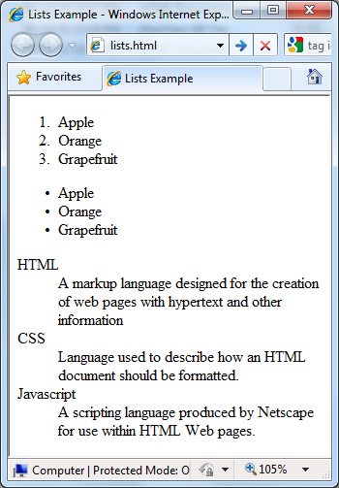
Lists – Example
lists.html
<ol type="1">
<li>Apple</li>
<li>Orange</li>
<li>Grapefruit</li>
</ol>
<ul type="disc">
<li>Apple</li>
<li>Orange</li>
<li>Grapefruit</li>
</ul>
<dl>
<dt>HTML</dt>
<dd>A markup lang…</dd>
</dl>

Slide 60

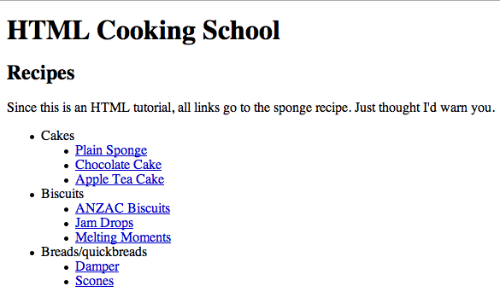

Creating Lists
Live Demo

Slide 61
HTML Special Characters
Symbol Name
HTML Entity
Symbol
Copyright Sign
&copy;
©
Registered Trademark Sign
&reg;
®
Trademark Sign
&trade;
™
Less Than
&lt;
<
Greater Than
&gt;
>
Ampersand
&amp;
&
Non-breaking Space
&nbsp;
Em Dash
&mdash;
—
Quotation Mark
&quot;
"
Euro
&#8364;
€
British Pound
&pound;
£
Japanese Yen
&yen;
¥
61

Slide 62
Special Characters – Example
special-chars.html
<p>[&gt;&gt;&nbsp;&nbsp;Welcome
&nbsp;&nbsp;&lt;&lt;]</p>
<p>&#9658;I have following cards:
A&#9827;, K&#9830; and 9&#9829;.</p>
<p>&#9658;I prefer hard rock &#9835;
music &#9835;</p>
<p>&copy; 2006 by Svetlin Nakov &amp; his team</p>
<p>Telerik Academy™</p>

Slide 63
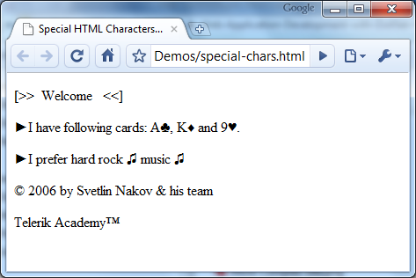
Special Chars – Example (2)
special-chars.html
<p>[&gt;&gt;&nbsp;&nbsp;Welcome
&nbsp;&nbsp;&lt;&lt;]</p>
<p>&#9658;I have following cards:
A&#9827;, K&#9830; and 9&#9829;.</p>
<p>&#9658;I prefer hard rock &#9835;
music &#9835;</p>
<p>&copy; 2006 by Svetlin Nakov &amp; his team</p>
<p>Telerik Academy™</p>

Slide 64
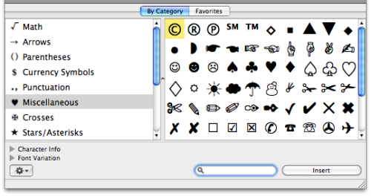
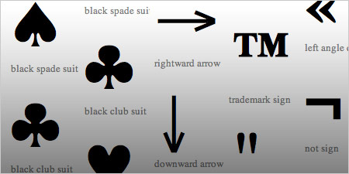
HTML Special Characters
Live Demo

Slide 65
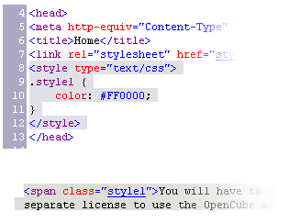

Using <DIV> and <SPAN> Block and Inline Elements

Slide 66
Block and Inline Elements
Block elements add a line break before and after them
<div> is a block element
Other block elements are <table>, <hr>, headings, lists, <p> and etc.
Inline elements don’t break the text before and after them
<span> is an inline element
Most HTML elements are inline, e.g. <a>

Slide 67
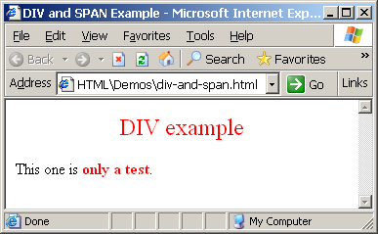
The <div> Tag
<div> creates logical divisions within a page
Block style element
Used with CSS
Example:
div-and-span.html
<div style="font-size:24px; color:red">DIV example</div>
<p>This one is <span style="color:red; font-weight:bold">only a test</span>.</p>

Slide 68


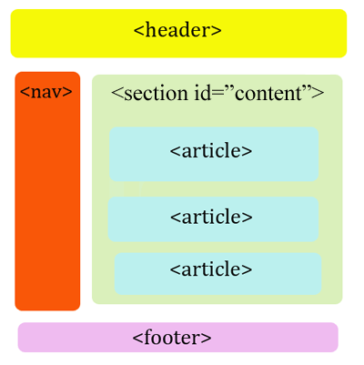
<DIV>
Live Demo
<DIV>

Slide 69
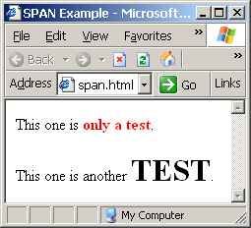
The <span> Tag
Inline style element
Useful for modifying a specific portion of text
Don't create a separate area (paragraph) in the document
Very useful with CSS
span.html
<p>This one is <span style="color:red; font-weight:bold">only a test</span>.</p>
<p>This one is another <span style="font-size:32px; font-weight:bold">TEST</span>.</p>

Slide 70


<SPAN>
Live Demo
<SPAN>some text</span>

Slide 71
HTML Basics
?
?
HTML, Text, Images, Tables, Forms
?
?
?
Questions?
?
?
?
?
?
http://academy.telerik.com

Slide 72
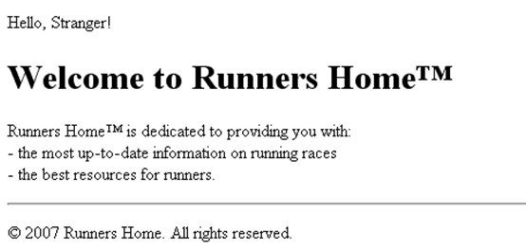
Exercises
Write an HTML page like the following:
* Use headings and divs

Slide 73
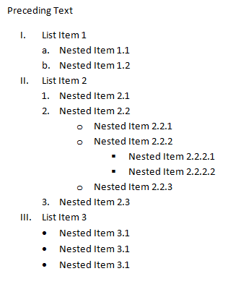
Exercises (2)
Write an HTML page like the following:
Write an HTML page looking like the PNG file named 3.Introduction.PNG. Using the <a> tag add anchors to the corresponding sections in the same page.

Slide 74
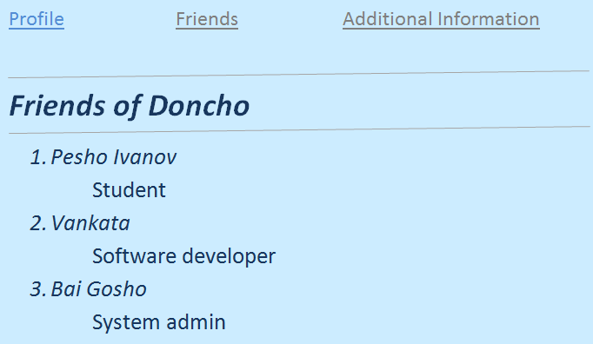
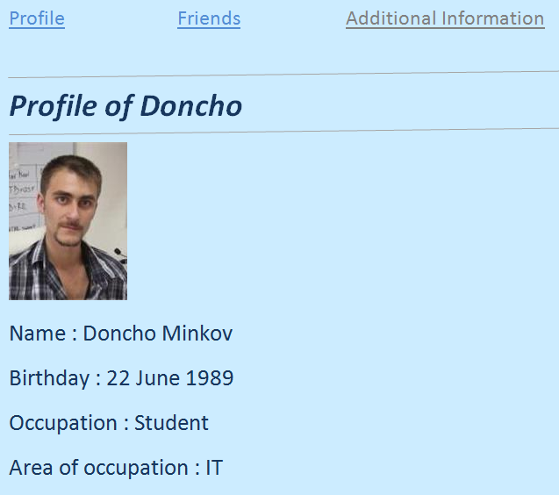
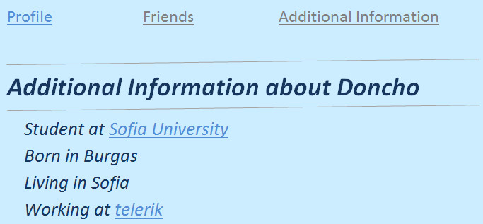
Exercises (3)
Create an user profile Web page Profile.html, friends page named Friends.html and info page named Info.html. Link them to one another using <a> tag.

Slide 75
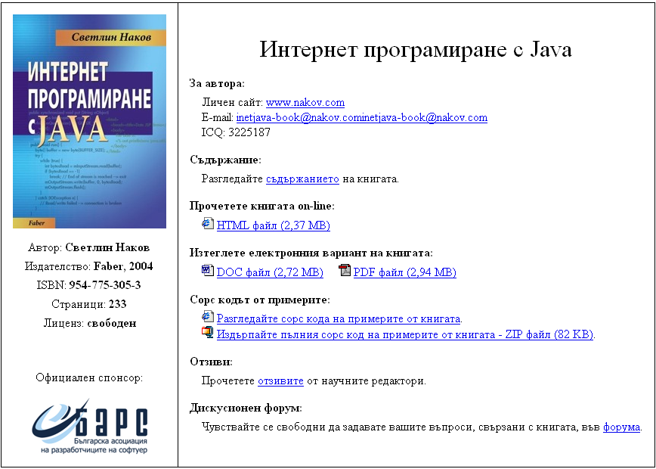
Exercises (4)
Create a Web site like the following:
See the image InetJava-site.png.

